Slide 1
COLLEGE WEBSITE
PROJECT ON
Presented By:
Godugu ManiTeja
Batch: 413FSD

Slide 2
ABSTRACT
We are going to make the college’s related website which will provide all information regarding our colleges. Now it is of Vital thing in the present scenario of any college where student can get all information before taking admission. This site provides the all information like student can easily get all information regarding their college infrastructure, facilities, training and placement and what are the course are available and includes other various details regarding college.
This can include detailed information about undergraduate, postgraduate, and doctoral programs, including course descriptions, faculty profiles, and research opportunities. Access to libraries, laboratories, and other academic resources, along with support services such as counseling and career guidance.

Slide 3
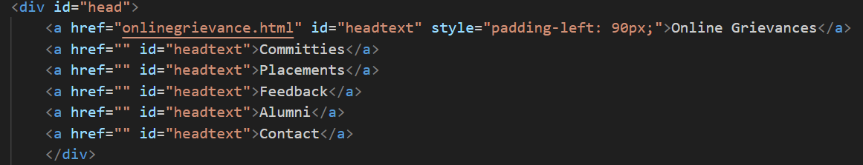
Header section
In this head section it contains online grievance by using link tag. This online grievance contains student or staff registration form.
This head section also includes
Committes
Placements
Feedback
Alumini
Contacts

Slide 4
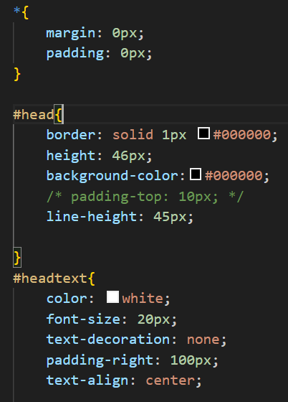
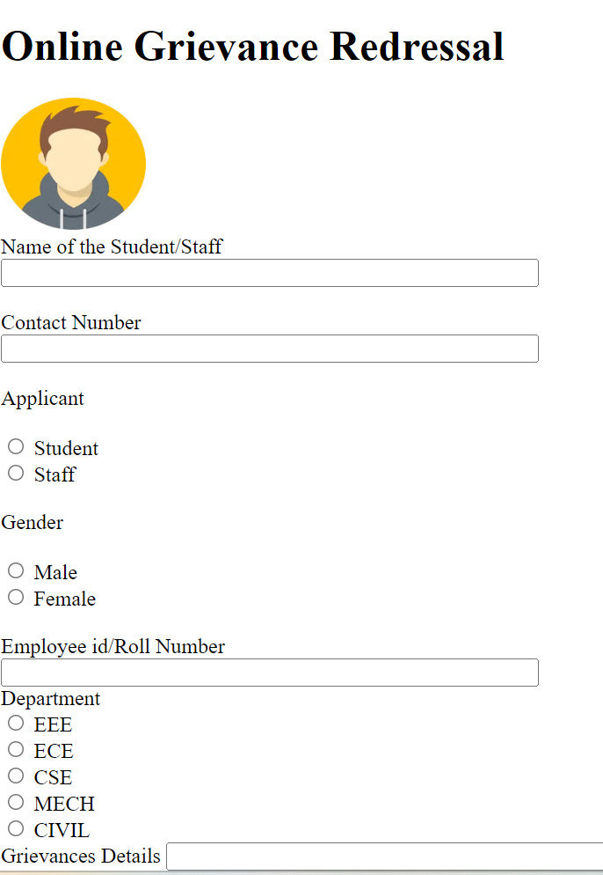
Head section

Slide 5
Out box
In this out box it contain box 1, box 2 and box 3.
The box 1 include college logo with specific height and width.
Box 2 include College name with grade ,college code and Ugc recognisition .
Box 3 include naac “A++” grade logo.
This out box are arranged with proper height and width and also using styling with css property.

Slide 6

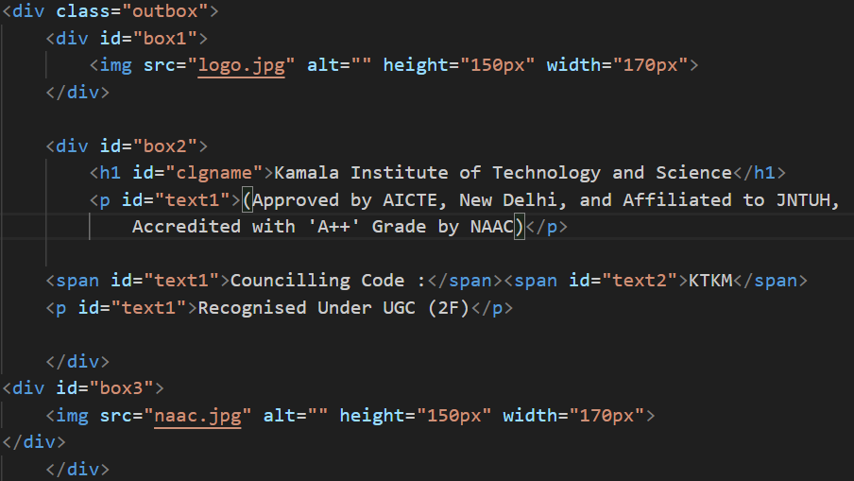

Out Box

Slide 7

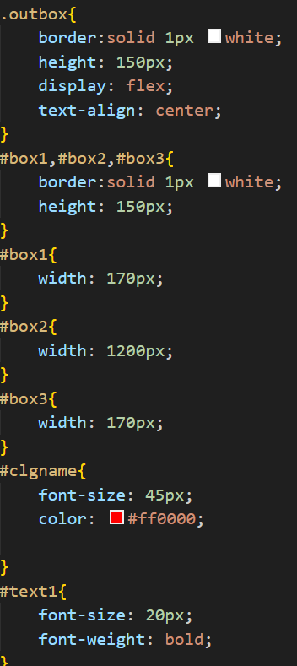
Box 2

Slide 8
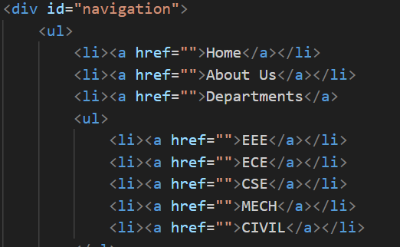
Navigation
In the navigation bar it includes home, about us ,departments, facilities, contact, feedback, administration, academics and main campus.

Slide 9
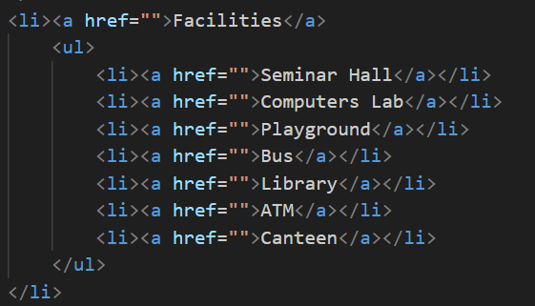
In the departments and facilities we can use <ul> list to display all other departments using drop command.

Slide 10
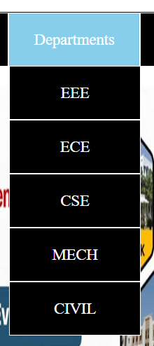
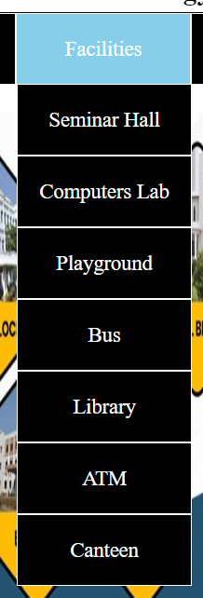
Navigation bar:

Slide 11
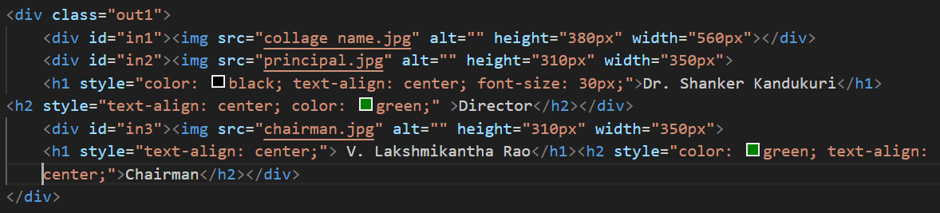
OUT BOX 1
In the outer box again this box divide into 3 sections which includes college name, director name and chairman name with images.
This 3 sections named with in1, in2, in3.

Slide 12


Slide 13
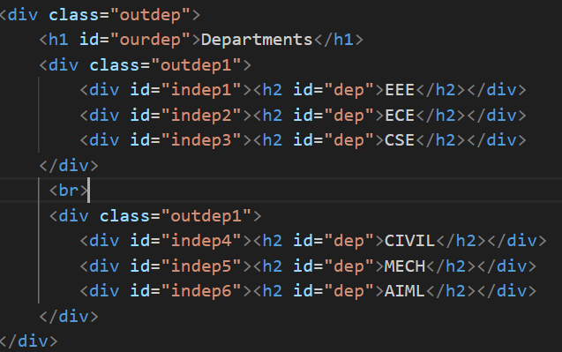
Departments
In this we can include various departments with images.

Slide 14
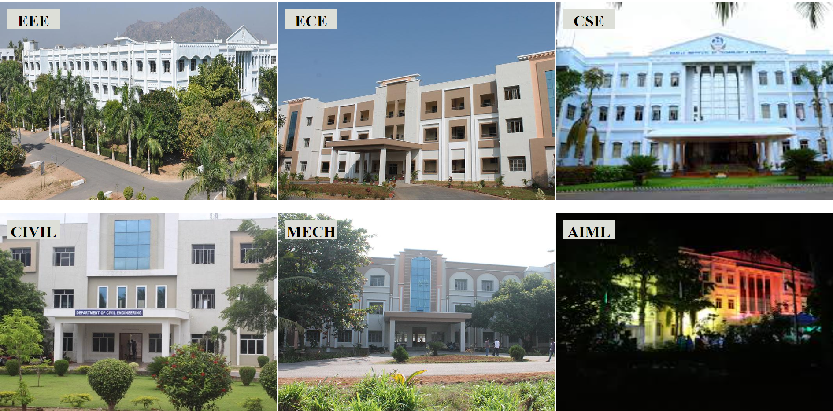

Slide 15
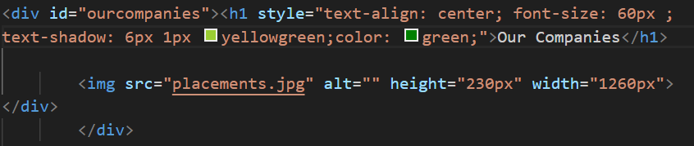
Our companies
In this placement companies are included, what are the compines are visited to our college.

Slide 16
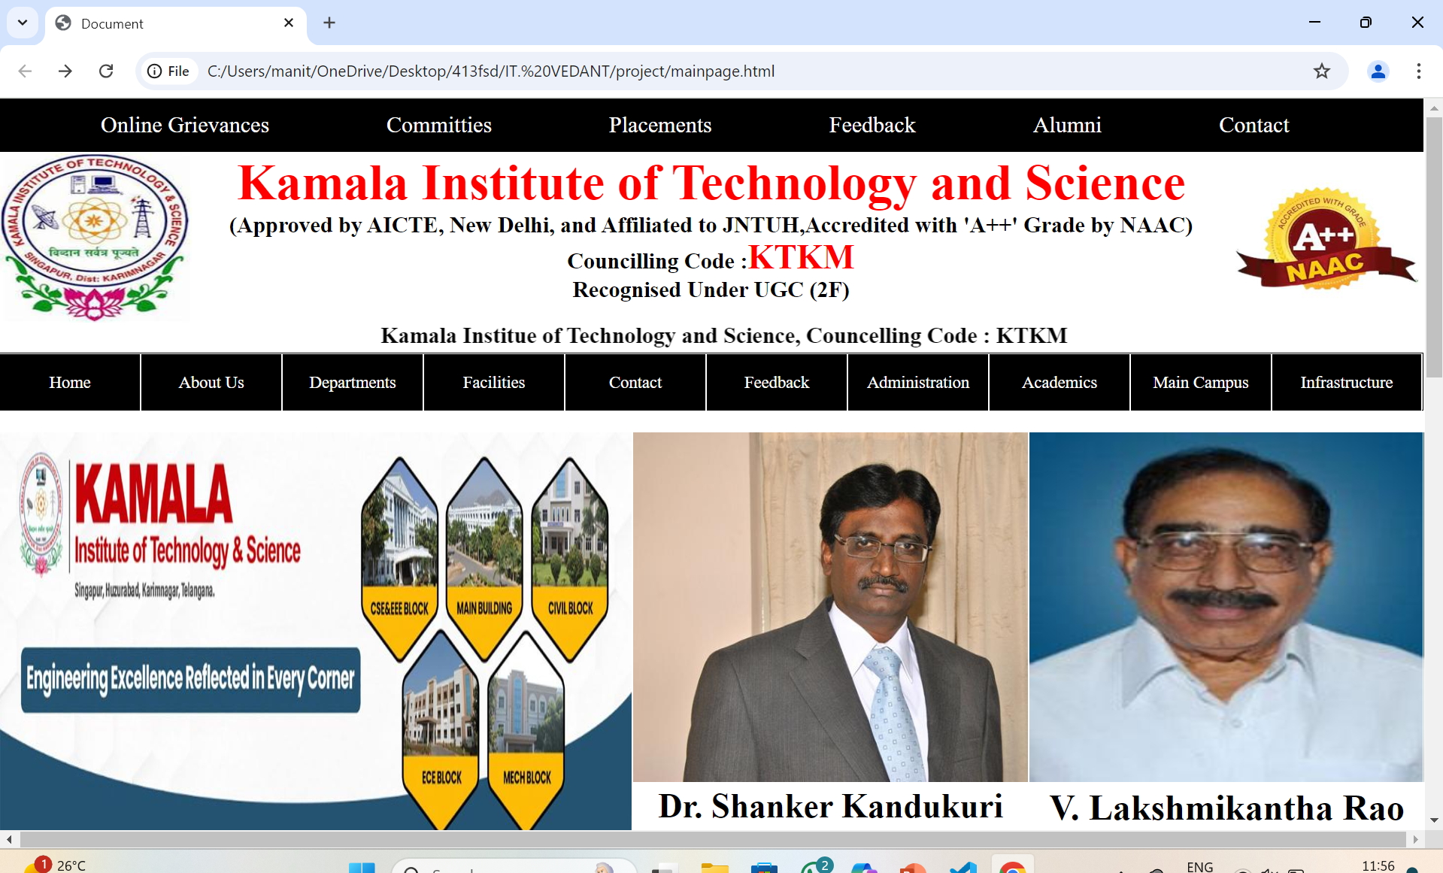
Final Output OF Website

Slide 17
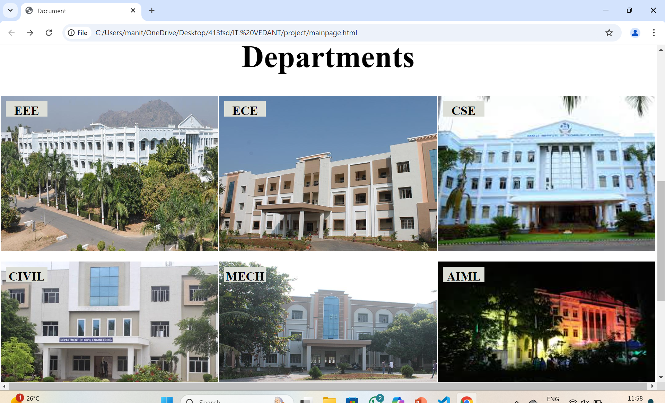

Slide 18
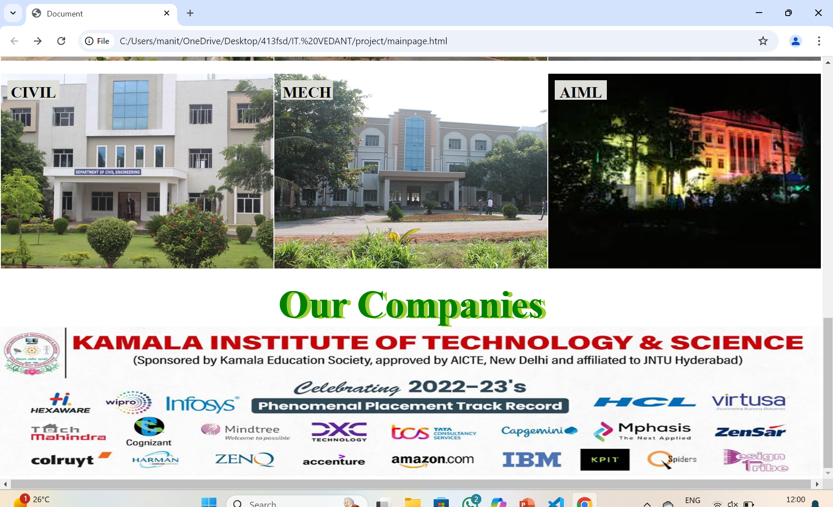

Slide 19


